Slide 1
Validation of P4 tools using Test Framework
At Intel Technologies India Pvt. Ltd.
By Shubham Pandey

Slide 2
Table of Content
Background Study (Simple NIC)
My Contribution
Automation of Testcase Generation
P4 for programming the data plane
Validation of P4 tools
Future Work
References

Slide 3
Few useful terms used in simple switch architecture
Plane : Group of algorithm is known as a plane.
Data Plane - How to process the data packet ?
Control Plane – How to use information to fill the routing table.
Both Data Plane and Control Plane interact with each other.

Slide 4
Router
Control Plane
Router uses the information to fill the Routing Table
Data Plane
Packets are processed in the data plane.
In simple NIC, data plane cannot be programmed.
Fig 1. Networking Planes

Slide 5
1. Background Study (Simple NIC)
NIC card (Network Interface Card) circuit board installed in a computer that provides a dedicated network connection. It is component without which a computer cannot be connected over a network.[1]
Data Plane algorithms were rigid and cannot be manipulated. To make packet processing faster it was kept as hardware restricted [4].
If we want to change the way packet is processed we need to go to the vendor of hardware and those people will change the packet processing and that may take 3-4 months

Slide 6
SmartNIC concept
SmartNIC offers reprogrammable data plane.
It reduces the burden of the CPU by offloading the packet processing. The processing on SmartNIC itself is as fast as on CPU.[1]
Advantages
Increases the performance.
Helps in renting out more cores.
To program the packet processing P4 language was created.

Slide 7
2. My Contribution
Automation of Testcase Generation using Python scripting.
P4 for programming the data plane
Validation of P4 tools.

Slide 8
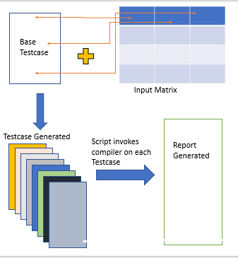
2. i) Automation of Testcase Generation.
Inputs :
Input Matrix
Base Testcases
Output :
Generated Testcases
Compilation Report

Slide 9
Advantages of Automation script
Days of work is reduced to hours of work.
Script can be easily handled by single person.
No. of testcases generated is equal to no. rows in input matrix.
Compilation Report is also generated.

Slide 10
2. ii) Programming Protocol-Independent Packet Processors(P4) Language
Distributed as Open Source and Developed in 2013 by P4 Laguage Consortium.
P4 is a programming language for controlling packet forwarding planes in networking devices, such as routers and switches
In a traditional switch the manufacturer defines the data-plane functionality.
A P4-programmable switch differs from a traditional switch. The data plane functionality is not fixed in advance but is defined by the a P4 program.[5]

Slide 11
API
Router / Switch
P4 Compiler
Control Plane
Data Plane
P4 program, an input to P4 Compiler
P4 Program
Extracted Headers
Parser
Match + Actions
Deparser
Packet in
Packet out

Slide 12
Core abstractions provided by P4 Language[2].
Headers
Specified as an ordered list of field names together with their widths.
header ethernet{
fields{
dst_Addr : 48;
src_Adrr : 48;
ethertype : 16;
}
}

Slide 13
Packet Parser
A state machine that traverses packet headers from start to finish, extracting field values as it goes.
States can be user defined. Three fixed states Start, Accept and Reject. Extracted values sent to next Match Action.
Each transition is triggered by values in current header.
Parser start{ ethernet; }
Parser ethernet { switch(ethertype){
case 0x8 : ipv4;
default : reject;
}
}

Slide 14
Action Specification
Tells what to do when any match occurs in Match + action tables.
Can be primitive action or User defined actions.
Set_field(ethernet.ethetype, 2); // primitive actions
Increment(ethernet.ethetype);
Action user_defined _action(){ // user defined action
Set_field(ethernet.ethetype, 2);
Increment(ethernet.ethetype);
}

Slide 15
Table Specification
How the defined header fields are to be matched in the match+action.
The reads attribute declares which fields to match.
Actions attribute lists the possible actions.
table ipv4_table{
reads{ ethernet.dst_Addr;
ipv4.checksum; }
max_size : 2000;
Actions{ X1, Y1 : some_action();
X2, Y2 : some_action(); }
}

Slide 16
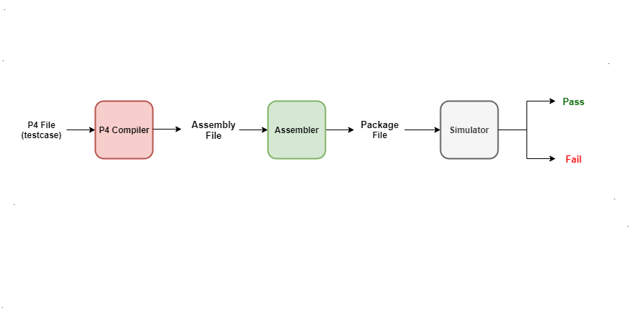
2. iii) Validation of P4 tools

Slide 17
To test different parameters of the hardware, error-checking, and code coverage of the compiler.
More than a thousand test cases are developed via a test framework written in python.
The framework takes P4 files and compiles them to create Assembly files.
Assembly files are converted to Package files via Intel Assembler, which is then fed into Intel’s Simulator Tool.
The Simulator initializes the registers from the Package file. The resultant output shows the success/failure of test cases.

Slide 18
3. Future Work
i. End-to-end explanation of packet processing in a Simple Switch/NIC using P4 Programmable blocks.
ii. Test case development for other programmable Blocks/Tools.
iii. Involvement into Compiler Block Development and Bug fixes.

Slide 19
4. References
[1] Tausanovitch, N., 2016. What makes a nic a smartnic, and why is it needed? Netronome, https://www.netronome.com/blog/what-makes-a-nic-a-smartnic-and-why-is-it-needed/.
[2] Consortium, T. P. L., 2017. P416 language specification. P4.org, https://p4.org/p4-spec/docs/P4-16-v1.0.0-spec.html
[3] Stephens, B., 2016. Your programmable nic should be a programmable switch. Programmable NICs, https://www.cs.uic.edu/~brents/docs/panic.hotnets18.pdf.
[4] Deierling, K., 2018. Defining the smartnic: What is a smartnic and how to choose the best one. Mellanox, https://blog.mellanox.com/2018/08/defining-smartnic/.
[5] McKeown, N., 2014. “P4: Programming protocol-independent packet processors”. ACMSIGCOMM Computer Communication Review, 44(3), July, pp. 88 – 95.

